Slide 1
COMPUTER NETWORKS
SESSION 01
INTRODUCTION to networks
Santoso Budijono

Slide 2
Learning outcomes
LO 1: Describe basic structures of network
LO 2: Explain basic concepts of network

Slide 3
Outline
Data Communications
Networks
Network Types
The Internet
Protocol Layering
TCP/IP Protocol Suite
OSI Model and TCP/IP Model
Network Devices
Virtual LANs

Slide 4
Data Communications
Data Communications
Data communications is the exchange of data between two devices via some form of transmission medium such as a wire cable or Wireless.
For data communications to occur, the communicating devices must be part of a communications system made up of a combination of hardware (physical equipment) and software (programs).
The effectiveness of a data communications system depends on four fundamental characteristics:
  Delivery
  Accuracy
  Timeliness, and
  Jitter

Slide 5
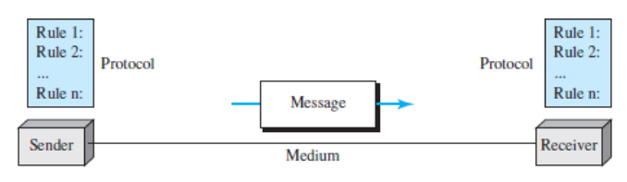
Data Communications
Components
The message is the information (data) to be communicated. Popular forms of information include text, numbers, Figures, audio, and video.
The sender is the device that sends the data message. It can be a computer, a telephone handset, a video camera, and so on.
The receiver is the device that receives the message. It can be a computer, workstation, telephone handset, television, and so on.
The transmission medium is the physical path by which a message travels from sender to receiver.
A protocol is a set of rules that govern data communications
Fig 1.1. Five components of a data communications system
Source : Data Communications and Networking with TCP/IP Protocol Suite. Forouzan, B. A.

Slide 6
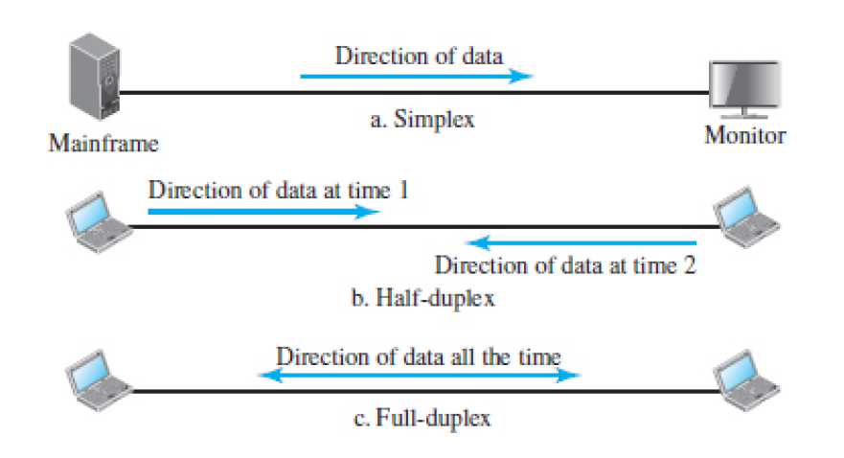
Data Communications
Data Flow
Fig. 1.2. Data flow (simplex, half-duplex, and full-duplex)
Source : Data Communications and Networking with TCP/IP Protocol Suite. Forouzan, B. A.

Slide 7
Networks
Network is the interconnection of a set of devices capable of communication.
A device can be a host, such as a large computer, desktop, laptop, workstation, cellular phone, or security system.
A device in this definition can also be a connecting device such as a router that connects the network to other networks, a switch that connects devices together, or a modem (modulator-demodulator) that changes the form of data.

Slide 8
Networks
Network Criteria
A network must be able to meet a certain number of criteria. The most important of these are :
  Performance
    Depends on Network Elements
    Measured in terms of Delay and Throughput
  Reliability
    Failure rate of network components
    Measured in terms of availability/robustness
  Security
    Data protection against corruption/loss of data due to:
      Errors
      Malicious users

Slide 9
Networks
Physical Structures
Type of Connection
  Point to Point - single transmitter and receiver
  Multipoint - multiple recipients of single transmission
Physical Topology
  Connection of devices
  The topology of a network

Slide 10
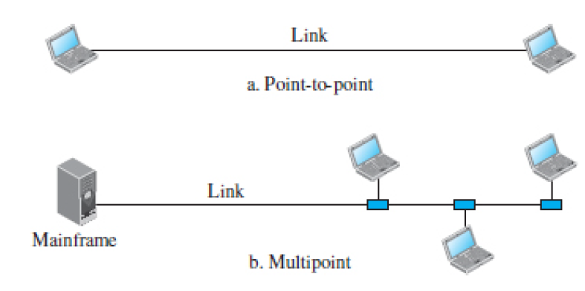
Networks
Types of connections
Fig. 1.4. Categories of topology)
Source : Data Communications and Networking with TCP/IP Protocol Suite. Forouzan, B. A.

Slide 11
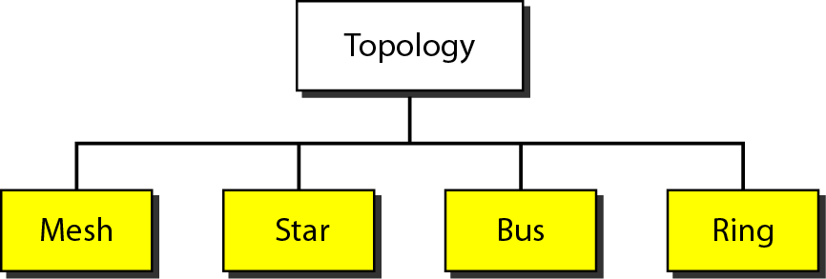
Networks
Physical Topology

Slide 12
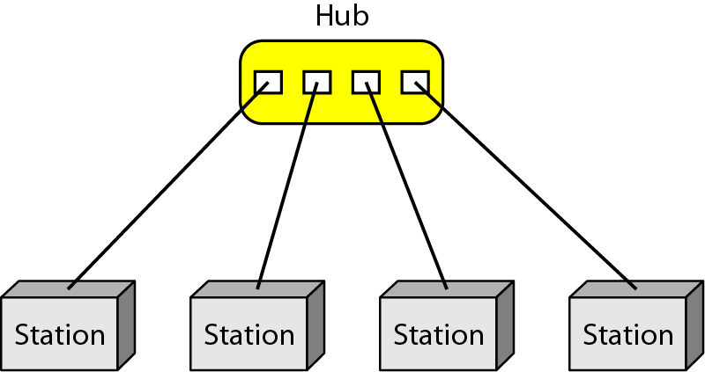
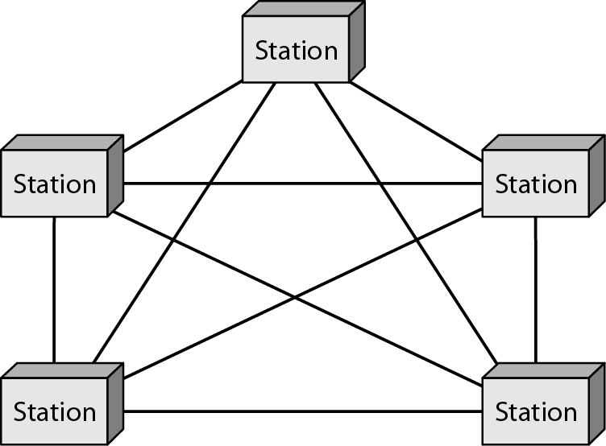

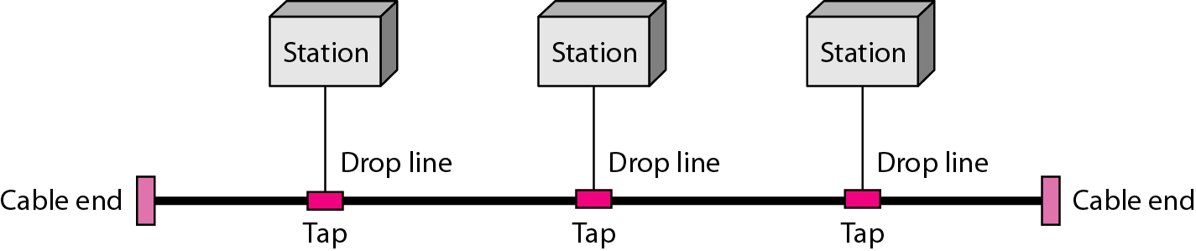
Networks
Topology – mesh – star- bus - ring
Fig 1.6. A star topology connecting four stations
Source : Data Communications and Networking with TCP/IP Protocol Suite. Forouzan, B. A.
Fig. 1.5. A fully connected mesh topology (five devices)
Source : Data Communications and Networking with TCP/IP Protocol Suite. Forouzan, B. A.
Fig 1.7. A bus topology connecting three stations
Source : Data Communications and Networking with TCP/IP Protocol Suite. Forouzan, B. A.
Fig 1.8. A ring topology connecting six stations
Source : Data Communications and Networking with TCP/IP Protocol Suite. Forouzan, B. A.

Slide 13
Networks types
Categories of Networks
Local Area Networks (LANs)
  Short distances
  Designed to provide local interconnectivity
Wide Area Networks (WANs)
  Long distances
  Provide connectivity over large areas
Metropolitan Area Networks (MANs)
  Provide connectivity over areas such as a city, a campus

Slide 14
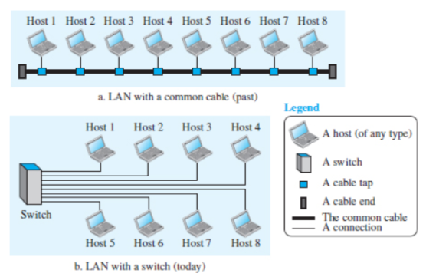
Networks types
LAN

Slide 15
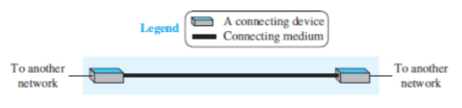
Networks types
LAN
Fig 1.10. A point-to-point WAN
Source : Data Communications and Networking with TCP/IP Protocol Suite. Forouzan, B. A.

Slide 16
Networks types
WAN

Slide 17
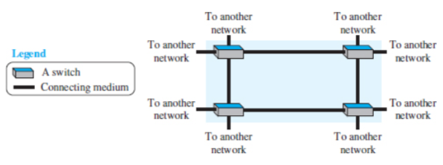
Networks types
WAN

Slide 18
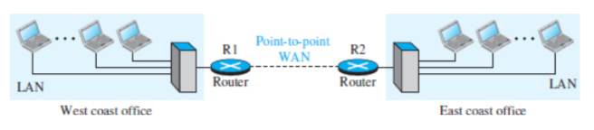
Networks types
WAN

Slide 19
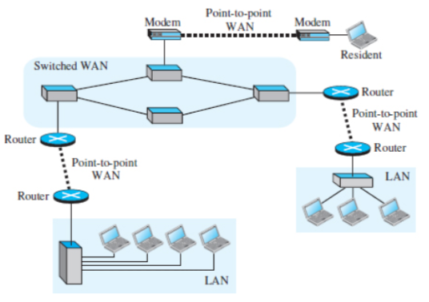
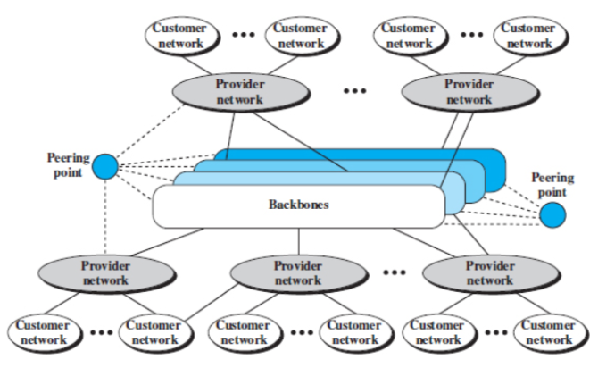
The Internet
The Internet has revolutionized many aspects of our daily lives. It has affected the way we do business as well as the way we spend our leisure time. The Internet is a communication system that has brought a wealth of information to our fingertips and organized it for our use.

Slide 20
The Internet
Accessing the Internet
The Internet today is an internetwork that allows any user to become part of it. The user, however, needs to be physically connected to an ISP.
The physical connection is normally done through a point-to-point WAN (such as a
  Telephone network,
  Cable network,
  Wireless network, or
  Other types of networks).

Slide 21
Protocol Layering
In data communications and networking, a protocol defines the rules that both the sender and receiver and all intermediate devices need to follow to be able to communicate effectively.
Communication is simple, we may need only one simple protocol; when the communication is complex, we may need to divide the task between different layers, in which case we need a protocol at each layer, or protocol layering.

Slide 22
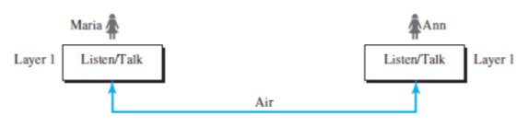
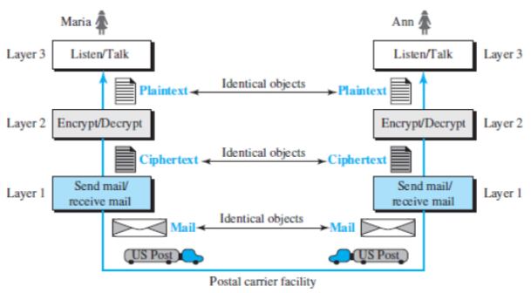
Protocol Layering
Single-layer protocol
Fig 1.15. A single-layer protocol
Source : Data Communications and Networking with TCP/IP Protocol Suite. Forouzan, B. A.
TCP/IP Protocol Suite
Three-layer protocol
Fig 1.16. A three-layer protocol
Source : Data Communications and Networking with TCP/IP Protocol Suite. Forouzan, B. A.

Slide 23
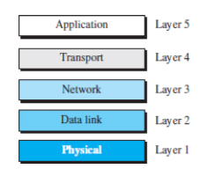
TCP/IP Protocol Suite
TCP/IP is a protocol suite (a set of protocols organized in different layers) used in the Internet today. It is a hierarchical protocol made up of interactive modules, each of which provides a specific functionality. The term hierarchical means that each upper-level protocol is supported by the services provided by one or more lower-level protocols. The TCP/IP protocol suite is defined as five layers.
Fig 1.17. Layers in the TCP/IP protocol suite
Source : Data Communications and Networking with TCP/IP Protocol Suite. Forouzan, B. A.

Slide 24
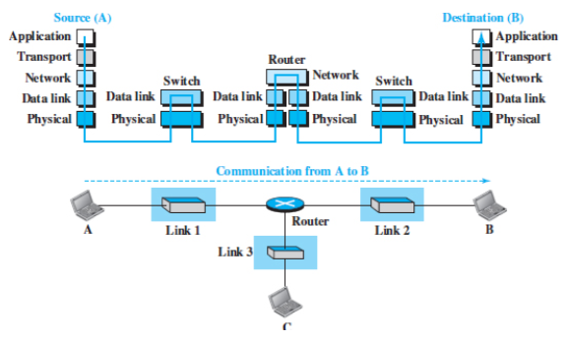
TCP/IP Protocol Suite
Layered Architecture
Fig 1.18. Communication through an internet
Source : Data Communications and Networking with TCP/IP Protocol Suite. Forouzan, B. A.

Slide 25
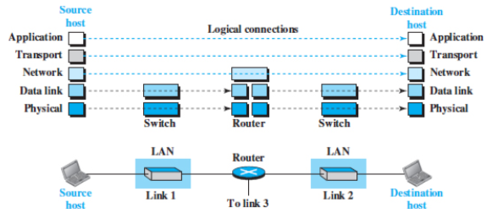
TCP/IP Protocol Suite
Brief Description of Layers
Fig 1.19. Logical connections between layers of the TCP/IP protocol suite
Source : Data Communications and Networking with TCP/IP Protocol Suite. Forouzan, B. A.

Slide 26
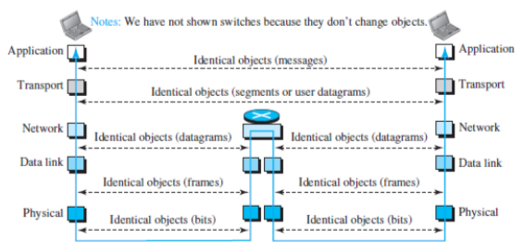
TCP/IP Protocol Suite
Brief Description of Layers
Fig 1.20. Identical objects in the TCP/IP protocol suite
Source : Data Communications and Networking with TCP/IP Protocol Suite. Forouzan, B. A.

Slide 27
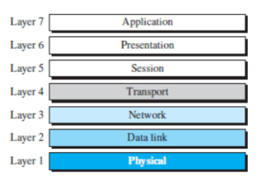
OSI Model and TCP/IP Model
International Organization for Standardization (ISO)
International Organization for Standardization (ISO) is a multinational body dedicated to worldwide agreement on international standards.
ISO standard that covers all aspects of network communications is the Open Systems Interconnection (OSI) model. It was first introduced in the late 1970s.
OSI model is a layered framework for the design of network systems that allows communication between all types of computer systems.
Fig 1.21. The OSI model
Source : Data Communications and Networking with TCP/IP Protocol Suite. Forouzan, B. A.

Slide 28
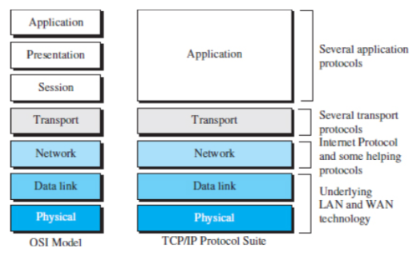
OSI Model and TCP/IP Model
OSI versus TCP/IP
Fig 1.22. TCP/IP and OSI model
Source : Data Communications and Networking with TCP/IP Protocol Suite. Forouzan, B. A.

Slide 29
References
Forouzan, B. A. (2021). Data Communications and Networking with TCP/IP Protocol Suite. 6th Ed. New York: McGraw-Hill. ISBN: 978-1-26-436335-3. Chapter 1 and 6.
https://ecomputernotes.com/computernetworkingnotes/communication-networks/what-is-data-communication
https://beginnersbook.com/2019/03/computer-network-topology-mesh-star-bus-ring-and-hybrid/
https://study-ccna.com/osi-tcp-ip-models/
https://www.youtube.com/watch?v=kCuyS7ihr_E
https://www.youtube.com/watch?v=Ilk7UXzV_Qc
https://www.youtube.com/watch?v=2QGgEk20RXM

Slide 30
Review Questions
For each of the following four networks, discuss the consequences if a connection fails.
  a. Five devices arranged in a mesh topology
  b. Five devices arranged in a star topology (not counting the hub)
  c. Five devices arranged in a bus topology
  d. Five devices arranged in a ring topology
B. What is the difference between half-duplex and full-duplex transmission modes?

Slide 31
Thank you
December 2024

